Slide 1
Lec - 7

Slide 2




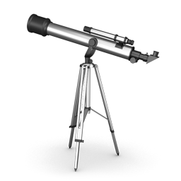

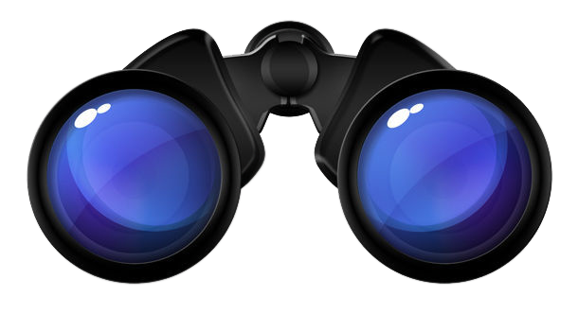
LENS
LENS
Magnifying glass
Spectacles
Contact lens
Binoculars
Microscope
Telescope

Slide 3




LENS
A lens is a transparent medium bound by two surfaces.
Converging
Diverging
Real focus
Virtual focus
Con
vex
Con
cave
a curve
outwards
a curve
inwards

Slide 4

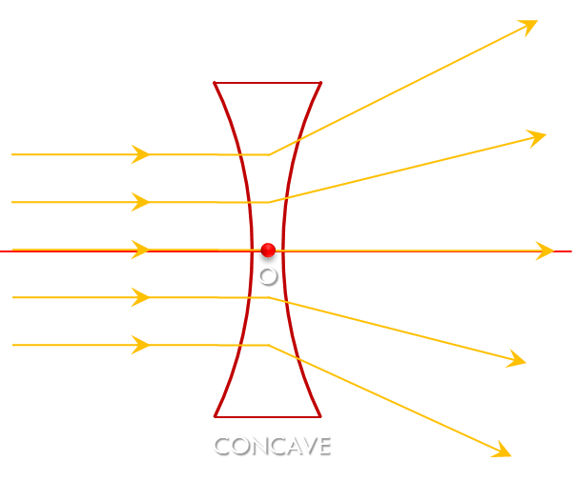
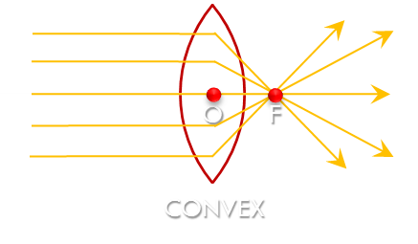
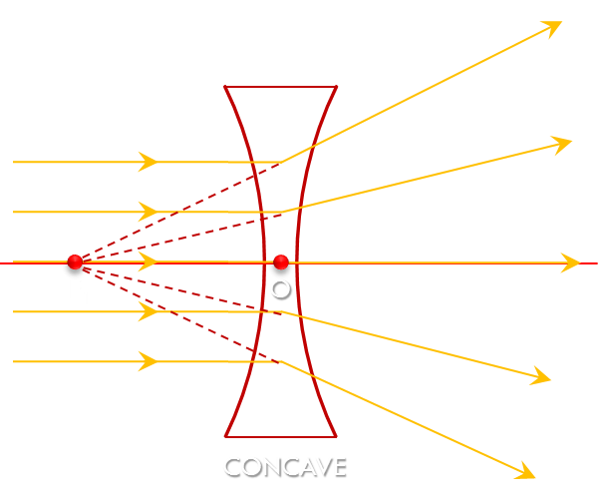
O
F
O
F₁
O
CONVEX
CONCAVE
CONCAVE
Distinguish between Convex and Concave lens
Convex
Concave
A lens which has two spherical surfaces curved outwards is called convex lens.
A lens which has two spherical surfaces curved inwards is called concave lens.
It is a converging lens.
It is a diverging lens.
It forms a real focus.
It forms a virtual focus.
It is thick in the centre and thin at the edges.
It is thin in the centre and thick at the edges.

Slide 5

Common Terms
Centre of curvature (C)
The centres of the spheres whose parts form surfaces of the lenses are called centres of curvatures of the lenses.
C₁ and C₂
Centre of curvature (C)
The radius of the spheres whose parts form surfaces of the lenses are called radii of curvature of the lenses.
Principal axis
O
R₁ and R₂
Principal axis
The imaginary line passing through both centres of curvature is called the principal axis of the lens.
Optical centre (O)
R₁
R₂
The point inside a lens on the principal axis, through which light rays pass without changing their path is called the optical centre of a lens.
Concavo –
Convex Lens
Convexo –
Concave Lens
Positive
Meniscus
Negative
Meniscus
C₁
C₂
C₁
C₂
2
1
S₁
S₂
S₁
S₂

Slide 6
Common Terms
Principal focus (F)
Convex Lens
(real focus)
When light rays parallel to the principal axis are incident on a convex lens, they converge to a point on a principal axis. This point is called the principal focus of the lens.
F₂
O
F₁
F₁ and F₂ are the principal foci of the convex lens.
Concave Lens
(virtual focus)
f
When light rays parallel to the principal axis are incident on a concave lens, they diverge and appear to be coming from a point on the principal axis. This point is called the principal focus of the lens.
F₁ and F₂ are the principal foci of the concave lens.
Focal length (f)
F₁
O
F₂
The distance between the optical centre and principal focus of a lens is called its focal length.
f

Slide 7










Positive meniscus
Optical Centre
A point from where light goes straight ?
Concave Lens
Which lens is this?
Thin in the centre and thick at edges
FREE POINT
FREE POINT
Concave lens has virtual focus
Concave lens has _________ focus
Concave lens
If rays appeal to diverge from a point then lens is
Principal axis
Imaginary line passing through c₁ and c₂
FREE POINT
FREE POINT
Negative Meniscus
Which lens is this?

Slide 8


RAY DIAGRAM
Lens showing a diminished and inverted image
But at what distance is it formed?

Slide 9

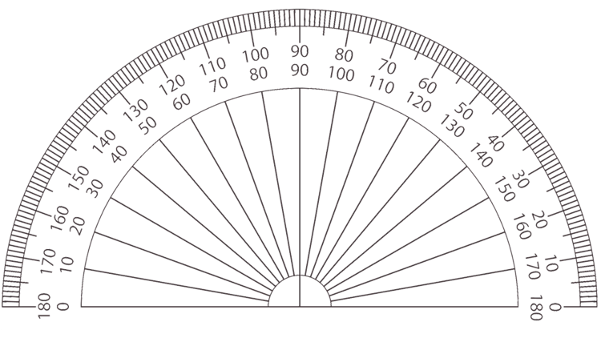
RAY DIAGRAM
BASIC DIAGRAM
2
2
2
2
2F₁
F₁
O
F₂
2F₂

Slide 10
RAY DIAGRAM
RULES FOR MAKING RAY DIAGRAMS
RULE
1
When the incident ray is parallel to the principal axis,
the refracted ray passes through the principal focus.
Incident ray
F₁
O
F₂
Refracted ray

Slide 11
RAY DIAGRAM
RULES FOR MAKING RAY DIAGRAMS
RULE
2
When the incident ray passes through the principal focus, the refracted ray is parallel to the principal axis.
Refracted ray
F₁
O
F₂
Incident ray

Slide 12
RAY DIAGRAM
RULES FOR MAKING RAY DIAGRAMS
RULE
3
When the incident ray passes through the optical centre,
it passes without changing its direction.
Incident ray
F₁
O
F₂
Refracted ray

Slide 13
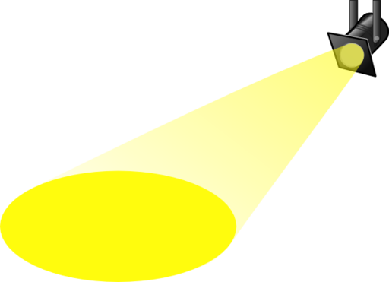
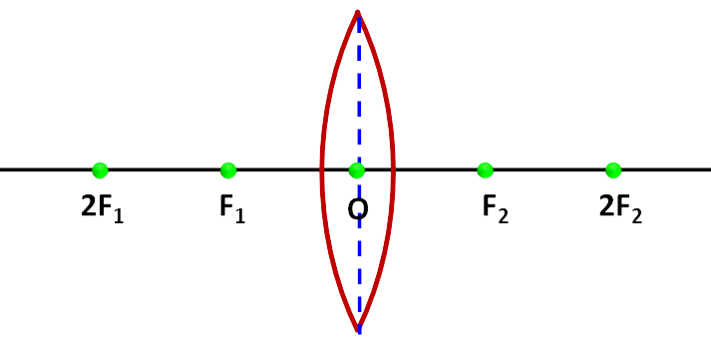
RULES FOR MAKING RAY DIAGRAM
INCIDENT RAY
REFRACTED RAY
Parallel to the principal Axis
Passes through focus
INCIDENT RAY
REFRACTED RAY
INCIDENT RAY
REFRACTED RAY
Passes through focus
Parallel to the principal Axis
Passes through O
Does not change direction

Slide 14
Thank You

